Slide 1
Jurassic World
Park Management System

Slide 2
INTRODUCTION

Slide 3
Purpose
1. The main objective of this document is to illustrate the requirements of the Park Management System.
2. The purpose of this project is to provide a friendly environment to users to explore the details of dinosaurs, view their tour details and book their tour tickets.
3. This project also allows the administrator to manage the park by updating information of dinosaurs, hotels and different tour packages.
4. This document describes the hardware and software interface requirements using ER diagrams and UML diagrams.

Slide 4
Scope
Scope of Park Management System is basically updating the manual park system(offline) into an internet-based application so that the users can know the details of their accounts, availability of tickets , different packages.
Project is specifically designed for both the use of visitors and administrator.
The project can be easily implemented under various situations.For eg: It can be modified to National Park Management System,etc

Slide 5
Overall Descriptions

Slide 6
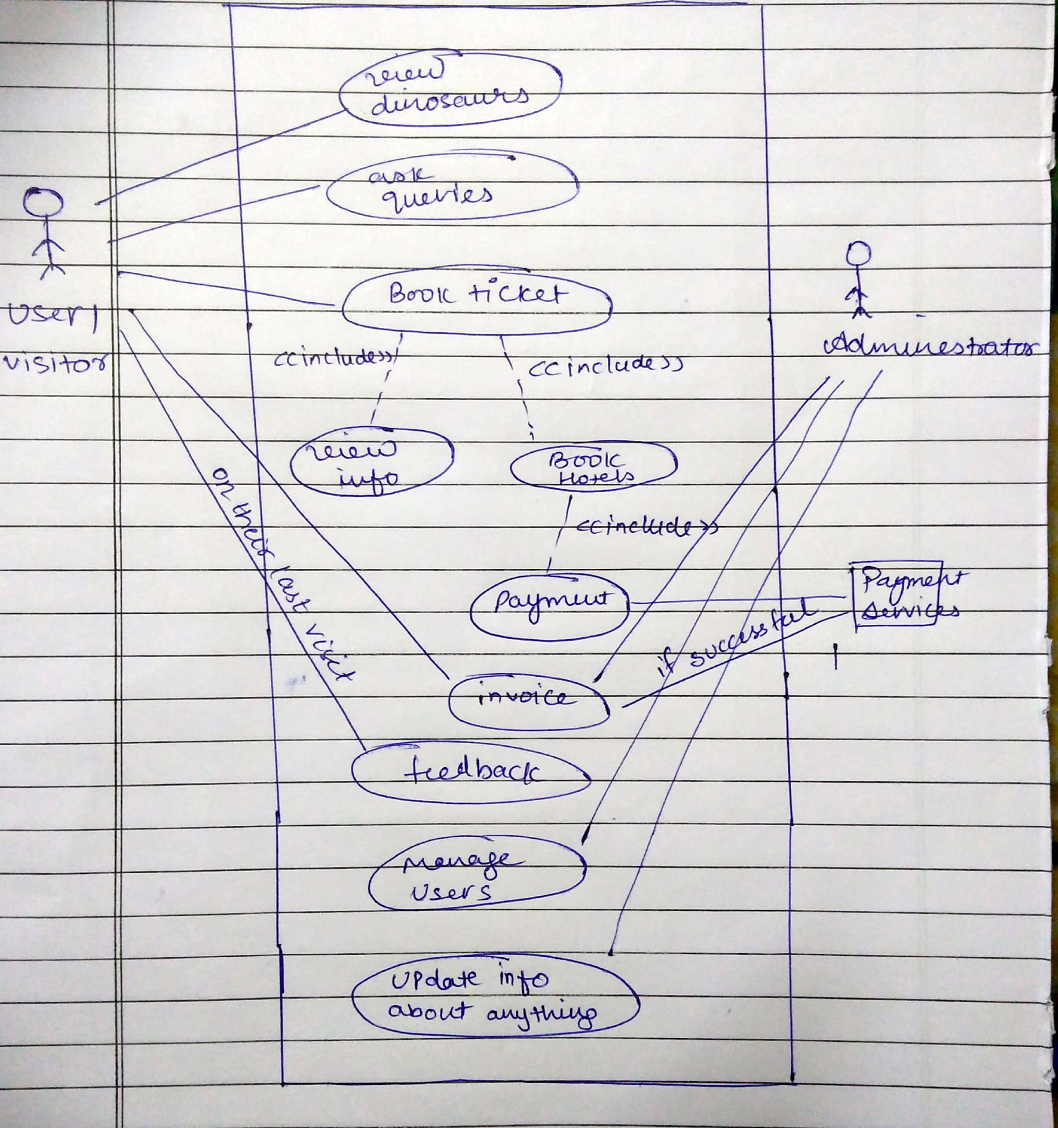
Product Perspective
Use Case UML Diagram

Slide 7
Product Functions
The Online Park System provides online real time information about the Tickets available in the Park and the user information. The main purpose of this project is to reduce the manual work. This software is capable of managing Ticket Issues, Cancellation, Managing hotels.
The manager will act as the administrator to control visitors and tickets.
The member’s status of book/cancellation is maintained in the Park database.
The member’s details can be fetched by the Manager from the database as and when required.
The valid members are also allowed to view their account information.

Slide 8
ER Diagram

Slide 9
Features available to the manager are:
Can add different genetic hybrid of dinosaurs(add dinosaurs information).
Respond to queries asked by users.
Add Hotel Information.

Slide 10
Features available to the users:
Can view the information of animals in the park
Can view his bookings
Update his account
Can put a request for booking(if granted then book the ticket).
Can ask any query related to park
Can submit the feedback related to his last tour
Have options available to select the hotels.

Slide 11
Relation Schemas
Login Table:
Login(username , name , contact , email , password)
Enquiry
Enquiry(name,email,comments)
Hotel
Hotel(h_id,h_name,loc,sacrooms,dacrooms,sacprice,dacprice)

Slide 12
Tickets
Tickets(sno,username,package,h_id,roomtype,norooms,adult,child,t_price,ssn,checkin,checkout)
feedback
feedback(fno,username,sno,rating,description)
Cards
Cards(cno,cname,cvv,month,year,balance)

Slide 13
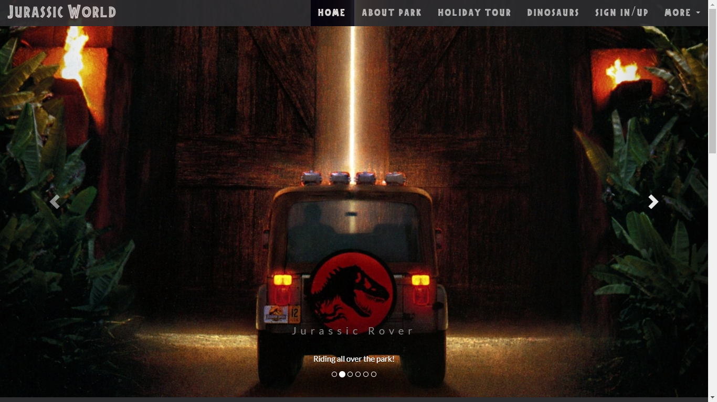
Glimpses
HomePage

Slide 14
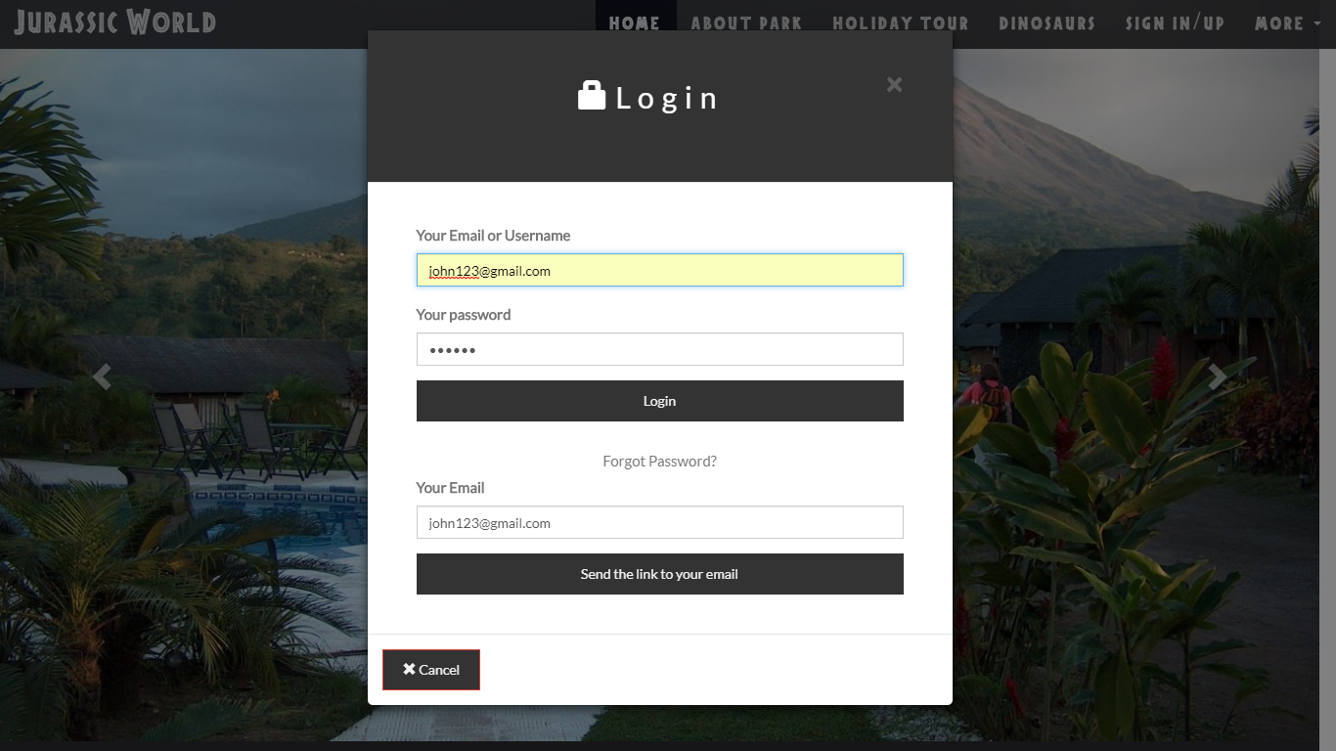
Login Form

Slide 15
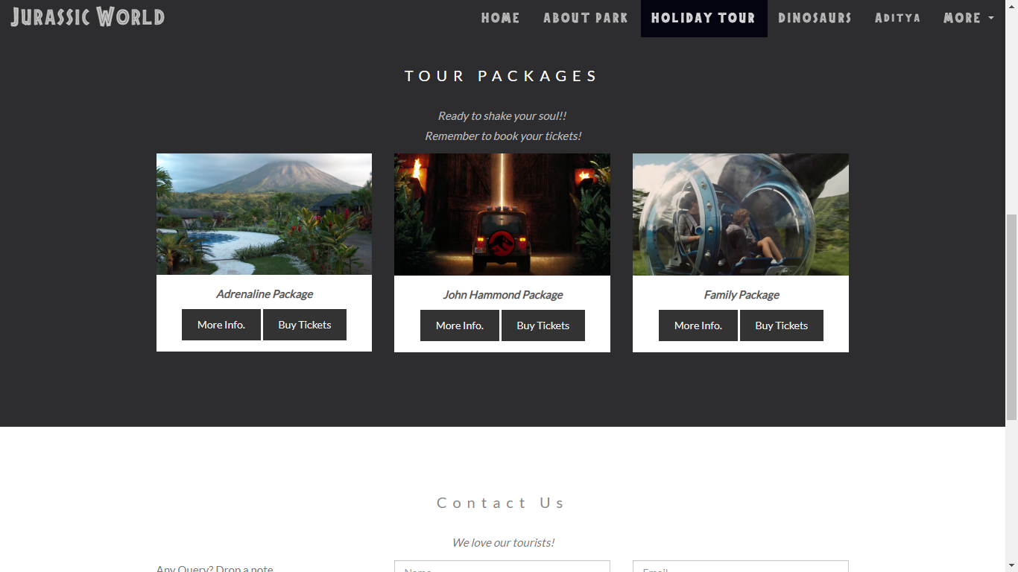
Tour Packages

Slide 16
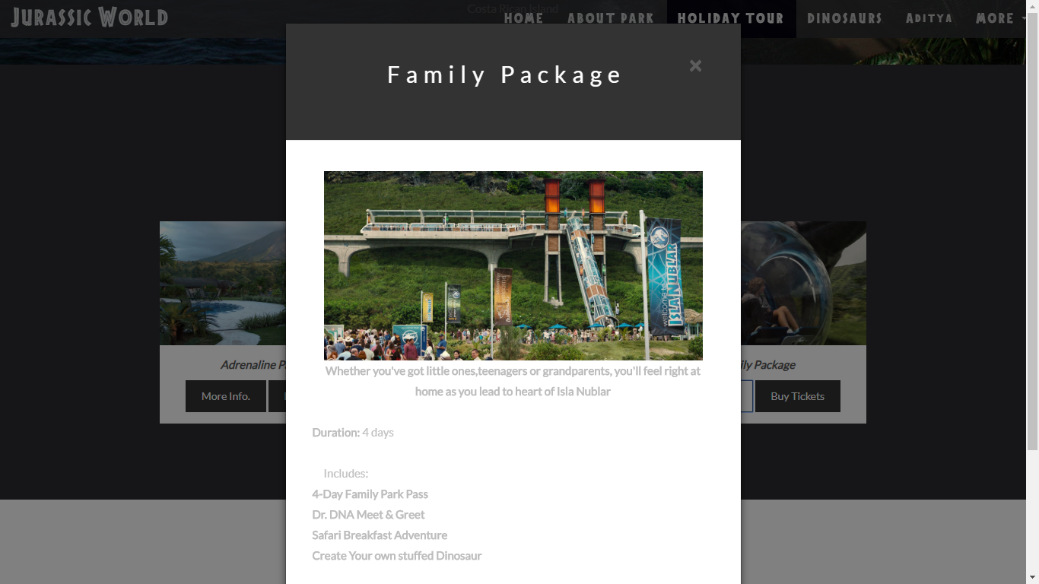
Package Information

Slide 17
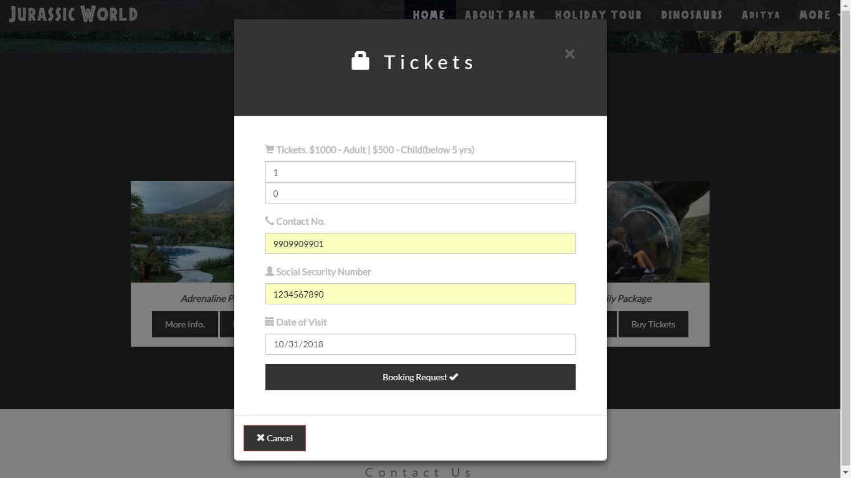
Ticket Booking Request

Slide 18
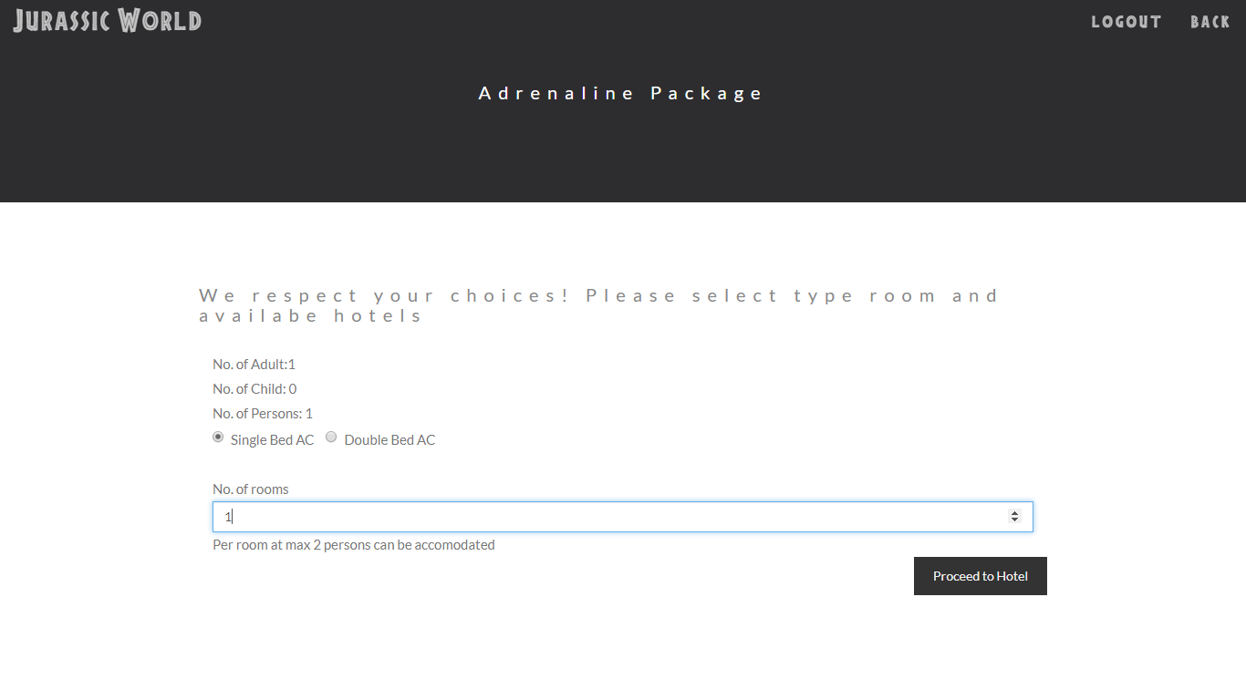
Room Type Information input

Slide 19
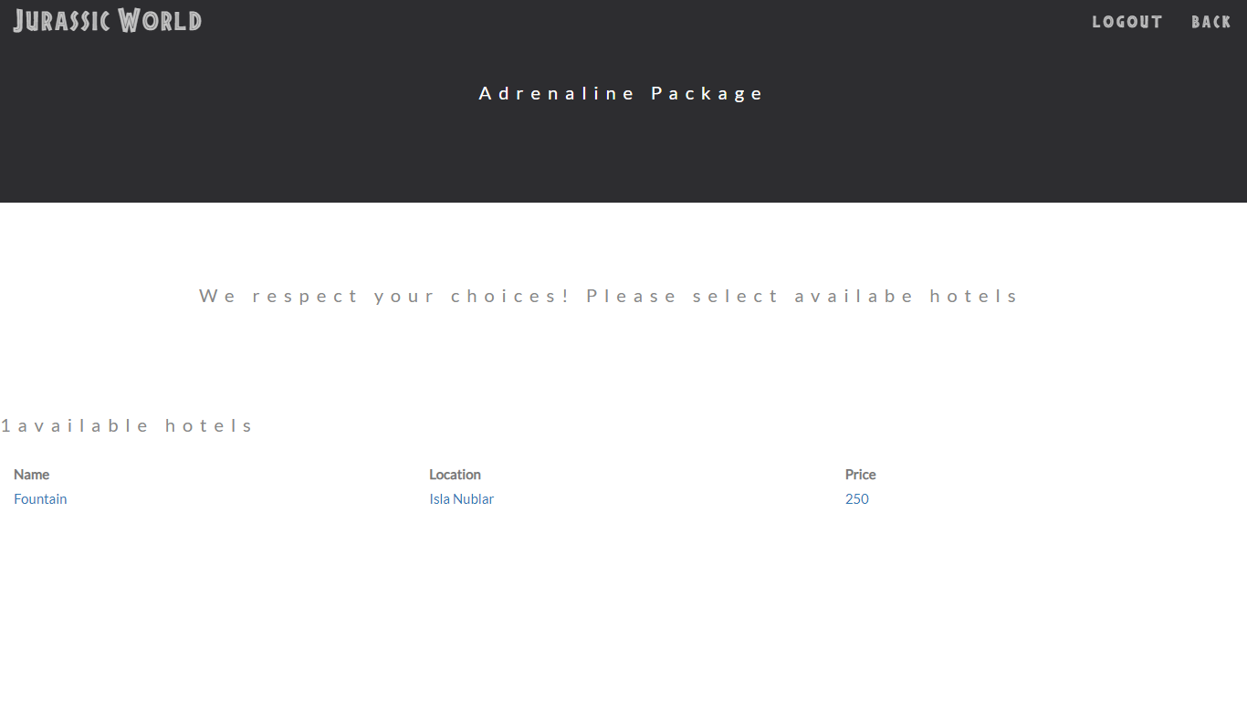
Select Hotel from available hotels

Slide 20
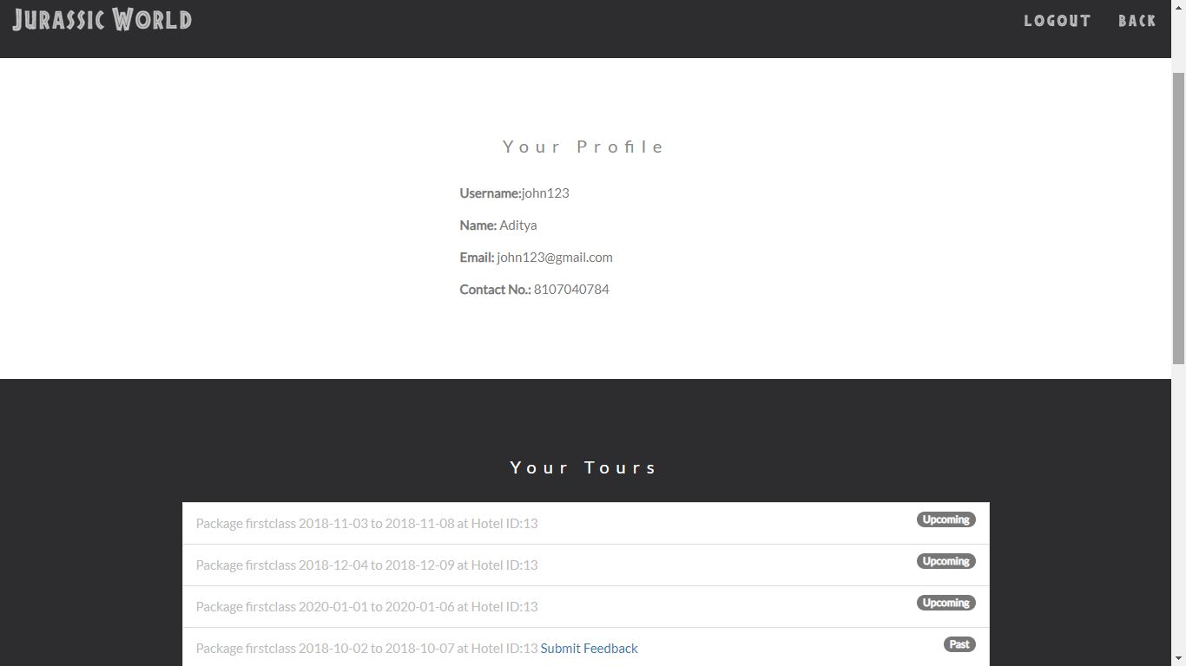
Dashboard

Slide 21
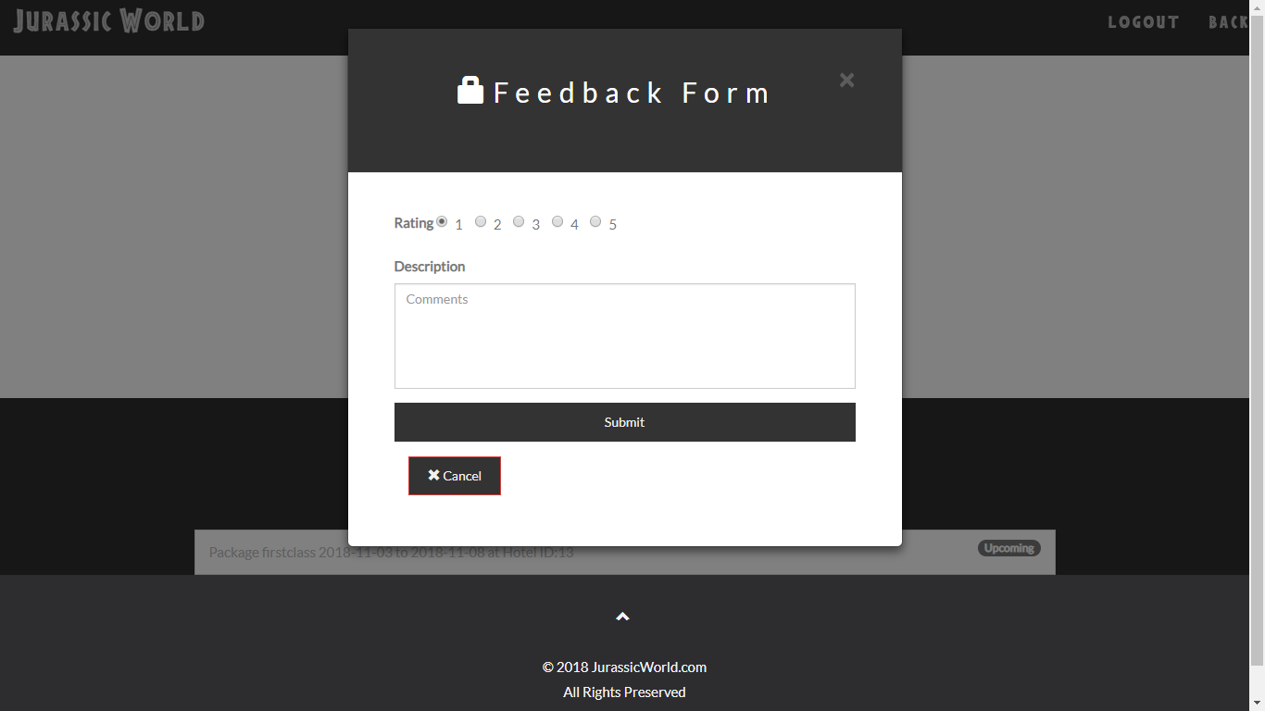
Feedback Form on past tours

Slide 22
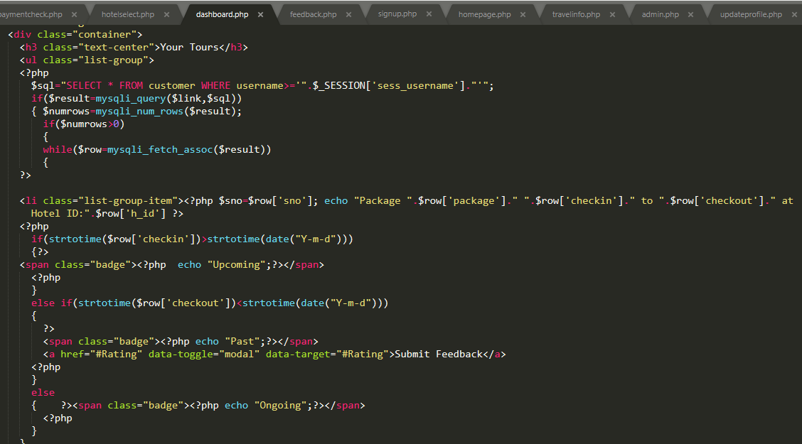
PHP Files
Query to select tickets of user and display into his/her dashboard

Slide 23
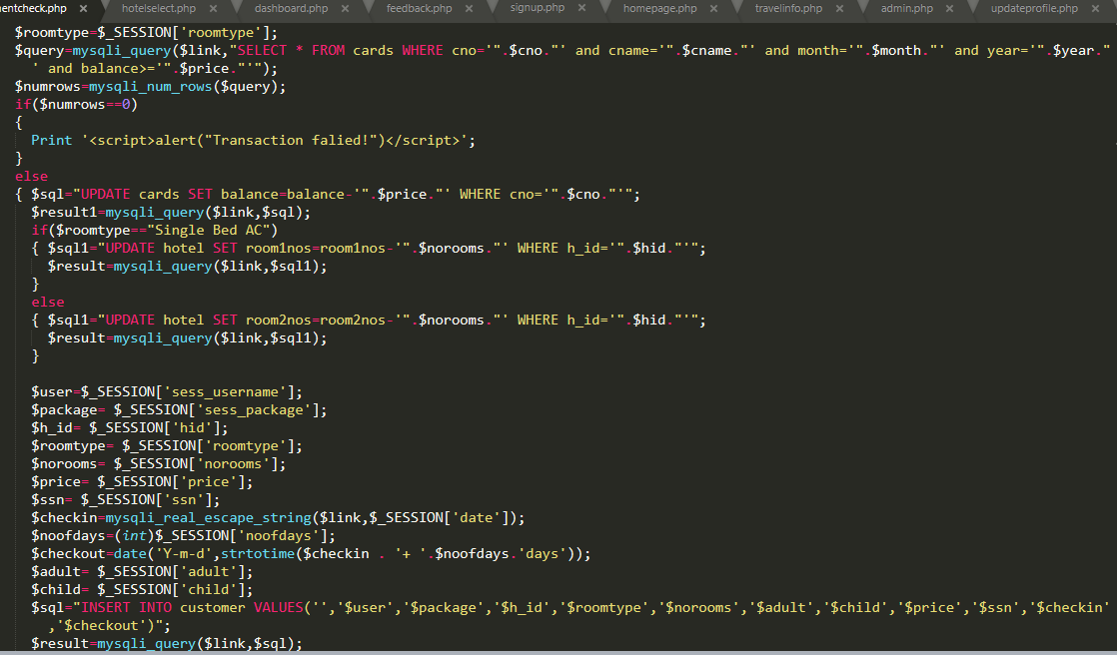
Payment validation,ticket generation,updation of hotel rooms,balance deduction

Slide 24
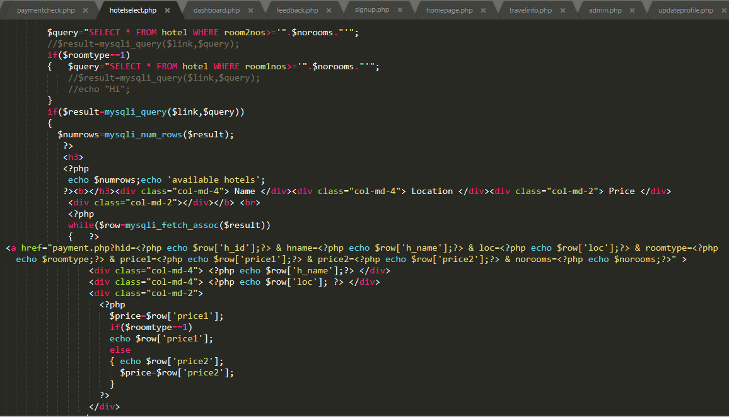
Display of available Hotel options after collecting roomtype and no. of rooms info.

Slide 25
THANK YOU

